Slide 1

3 – Tier architecture
Team member
Gnana sekar
Somasundaram
Manojic Arumugam
Nawin Karthik

Slide 2
why we use layer architecture ?
Layer - logical separation of related-functionality[code] within an application
Tier - Physical separation of layers which get hosted on Individual servers in an individual computer
why we use tier architecture ?

Slide 3
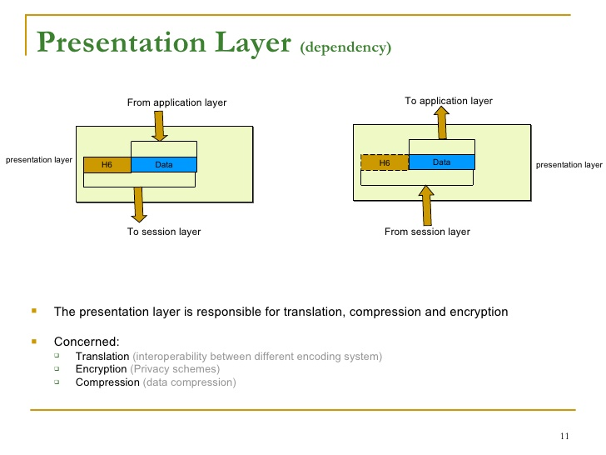

Slide 4
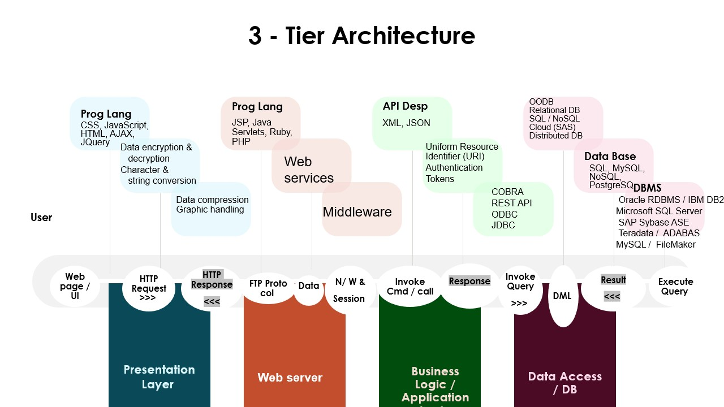

Slide 5
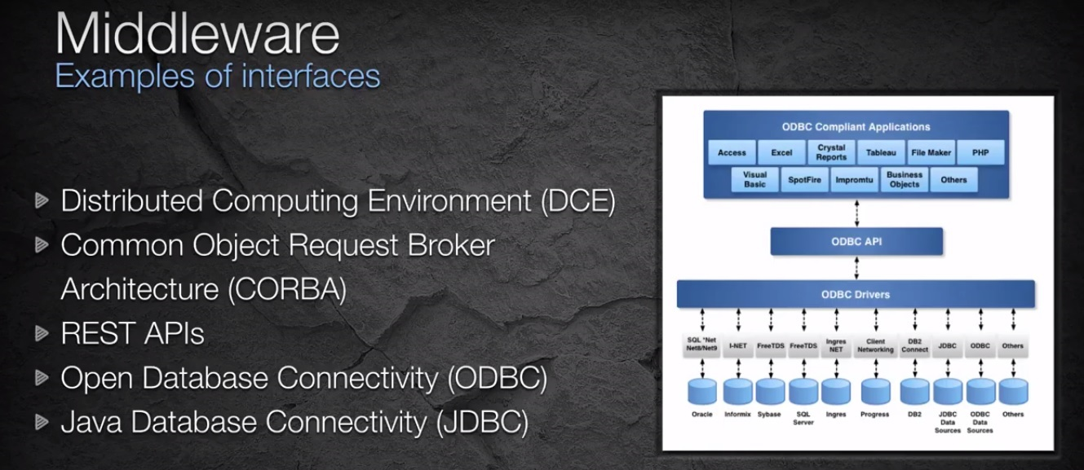

Slide 6
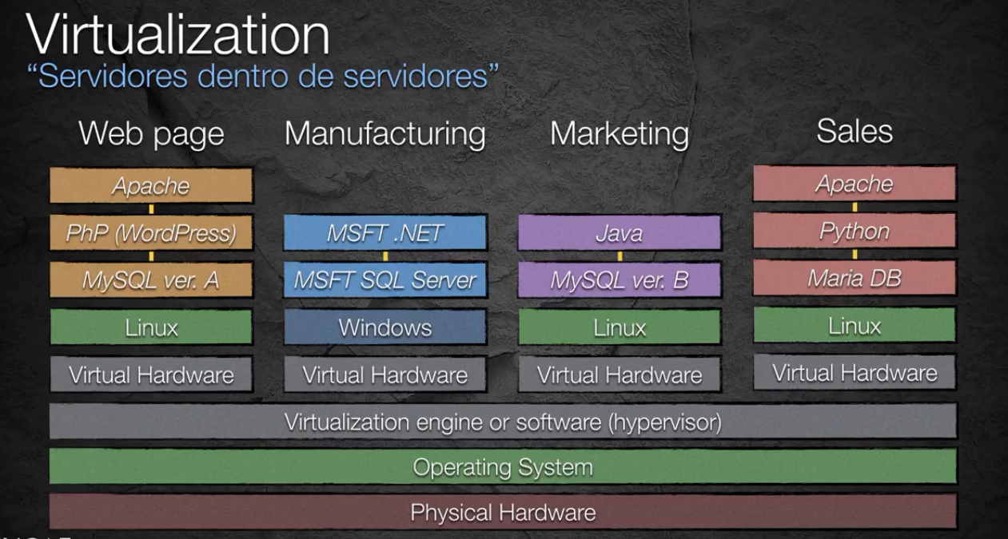

Slide 7
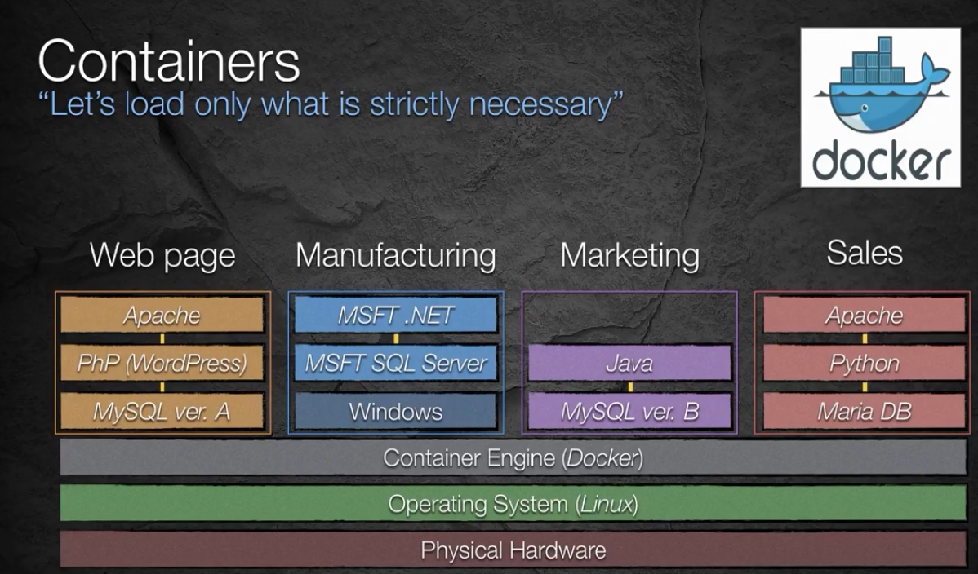

Slide 8
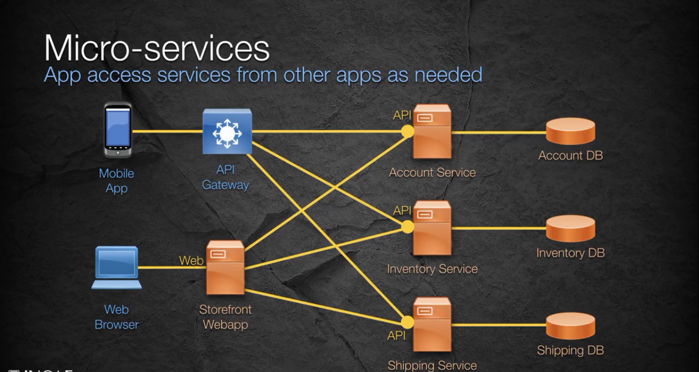

Slide 9

Advantage
Scalable – Scale separate tiers without touching other tiers(As your organisation grows You can scale up your DB-Tier with DB-Clustering without touching other tiers.)
Flexible – Expands in any way according to requirements(Easily Upgrade or Enhance [Ex: You can add Additional Application Code, Upgrade Storage Area, or even add Multiple presentation Layers for Separate devises like mobile, tablet, pc)
Secure – Each tier can be secured separately and in different ways
Individual management – Prevents cascade effects; isolates maintenance (Web designer can change the View-code, without touching the other layers on the other tiers.)

Slide 10
CRIS ?

Slide 11
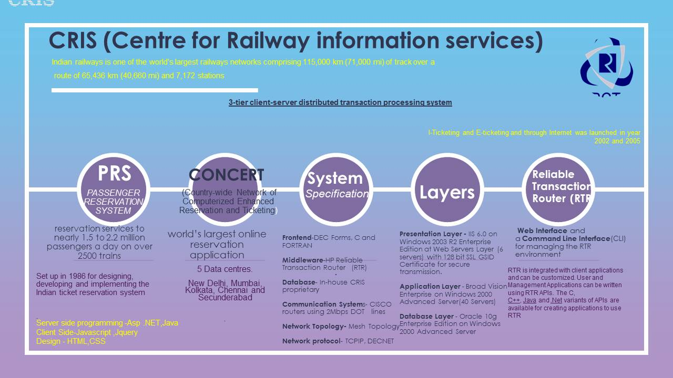

Slide 12

Thank You

